Slide 1
Data mining homework
Due at 6/20
Yu-Wei Chang <ernie55ernie@gmail.com>
Data set and other information available at https://github.com/ernie55ernie/2016DataMiningClass

Slide 2
Outline
Data set description
Available technique: forecast, classify, cluster, associate
Available tool: Weka
Simple example
How to start (project structure)
Other tools
Materials
Question

Slide 3
Data set description
Date arrival (person) Domestic GDP(millions) Tourism attractions (sum) CPI (2011 as 100) Average exchange rate (US dollars) GNI (millions) NI (millions) National park National scenic area Government-owned recreational area Privately-owned recreational area …

Slide 4
Data set description
More data
http://www.dgbas.gov.tw/mp.asp?mp=1 directorate-general of budget, accounting and statistics
http://stat.motc.gov.tw/mocdb/stmain.jsp?sys=100 ministry of transportation and communications R.O.C.
http://admin.taiwan.net.tw/public/public.aspx?no=315 tourism bureau, M.O.T.C. republic of china

Slide 5
Available technique: forecast, classify, cluster, associate
Linear Regression Model
Arrival (person) = -0.1648 * Domestic GDP(millions) + 0.0196 * CPI (2011 as 100) + 0.17 * GNI (millions) + -0.1443 * NI (millions) + …

Slide 6
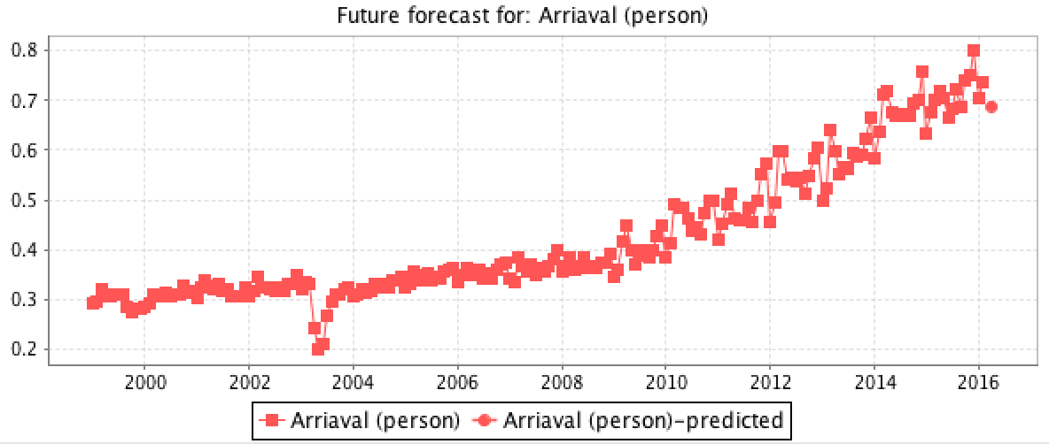
Available technique: forecast, classify, cluster, associate
Linear Regression Model
Arrival (person) = 0.0366 * Month=jul,sep,may,jun,feb,aug,oct,apr,mar,nov,dec + 0.019 * …
+ -0.0015 * Date-remapped*Lag_Arriaval (person)-10 + 0.0004 * Date-remapped*Lag_Arriaval (person)-11 + -0.0098

Slide 7
Available technique: forecast, classify, cluster, associate
Clustered Instances
0 99 ( 48%)
1 49 ( 24%)
2 59 ( 29%)

Slide 8
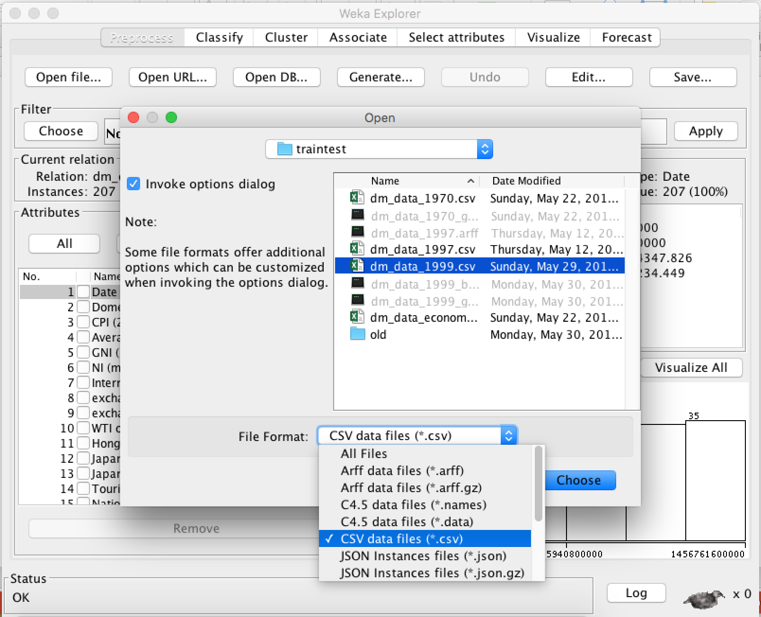
Available tool: Weka
Load data as csv

Slide 9
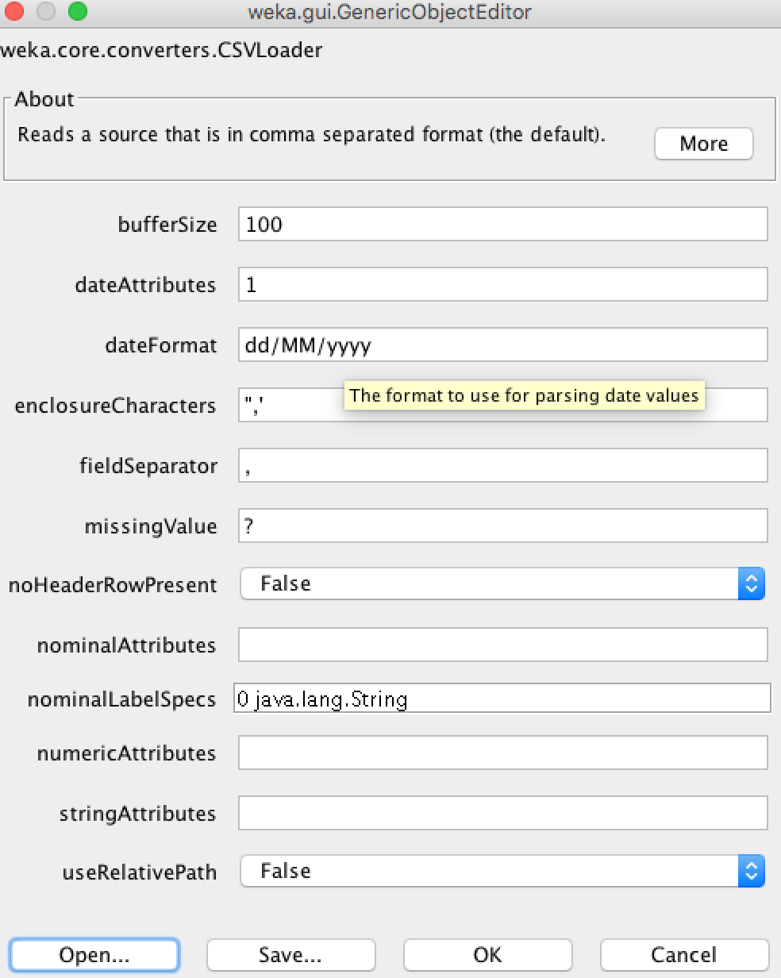
Available tool: Weka
Use converter

Slide 10
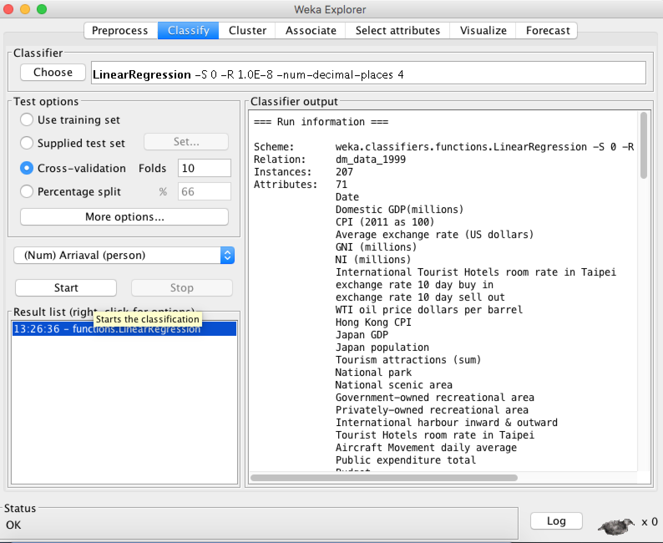
Available tool: Weka
Classify

Slide 11
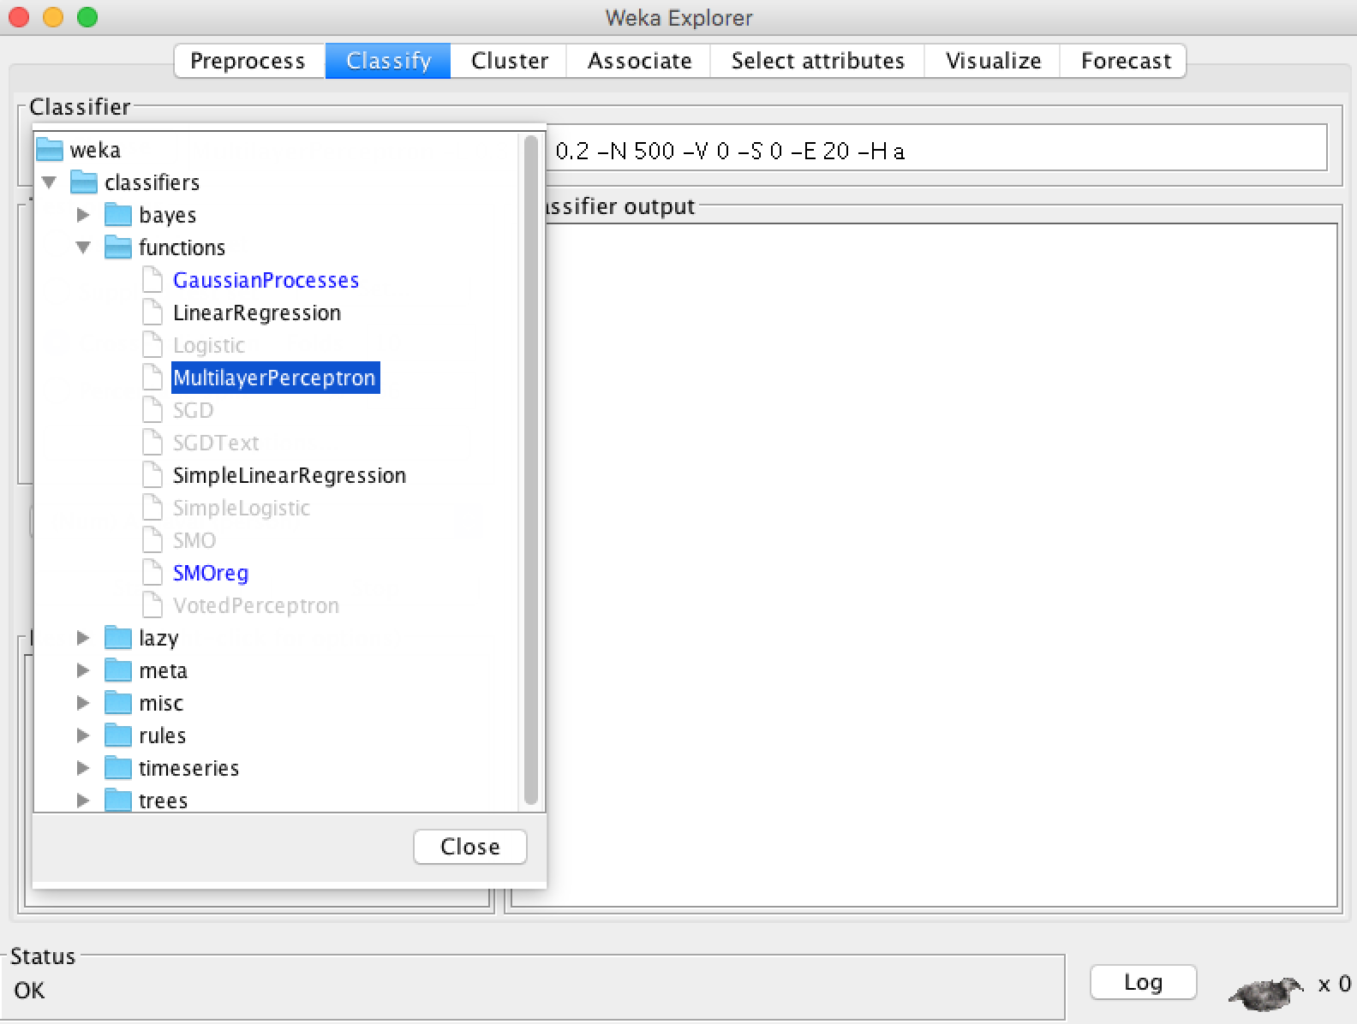
Available tool: Weka
Multilayer perception

Slide 12
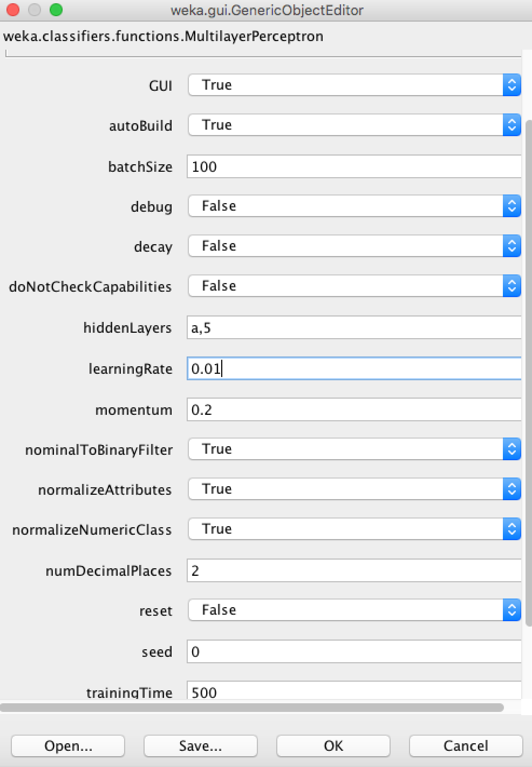
Available tool: Weka
Multilayer perception

Slide 13
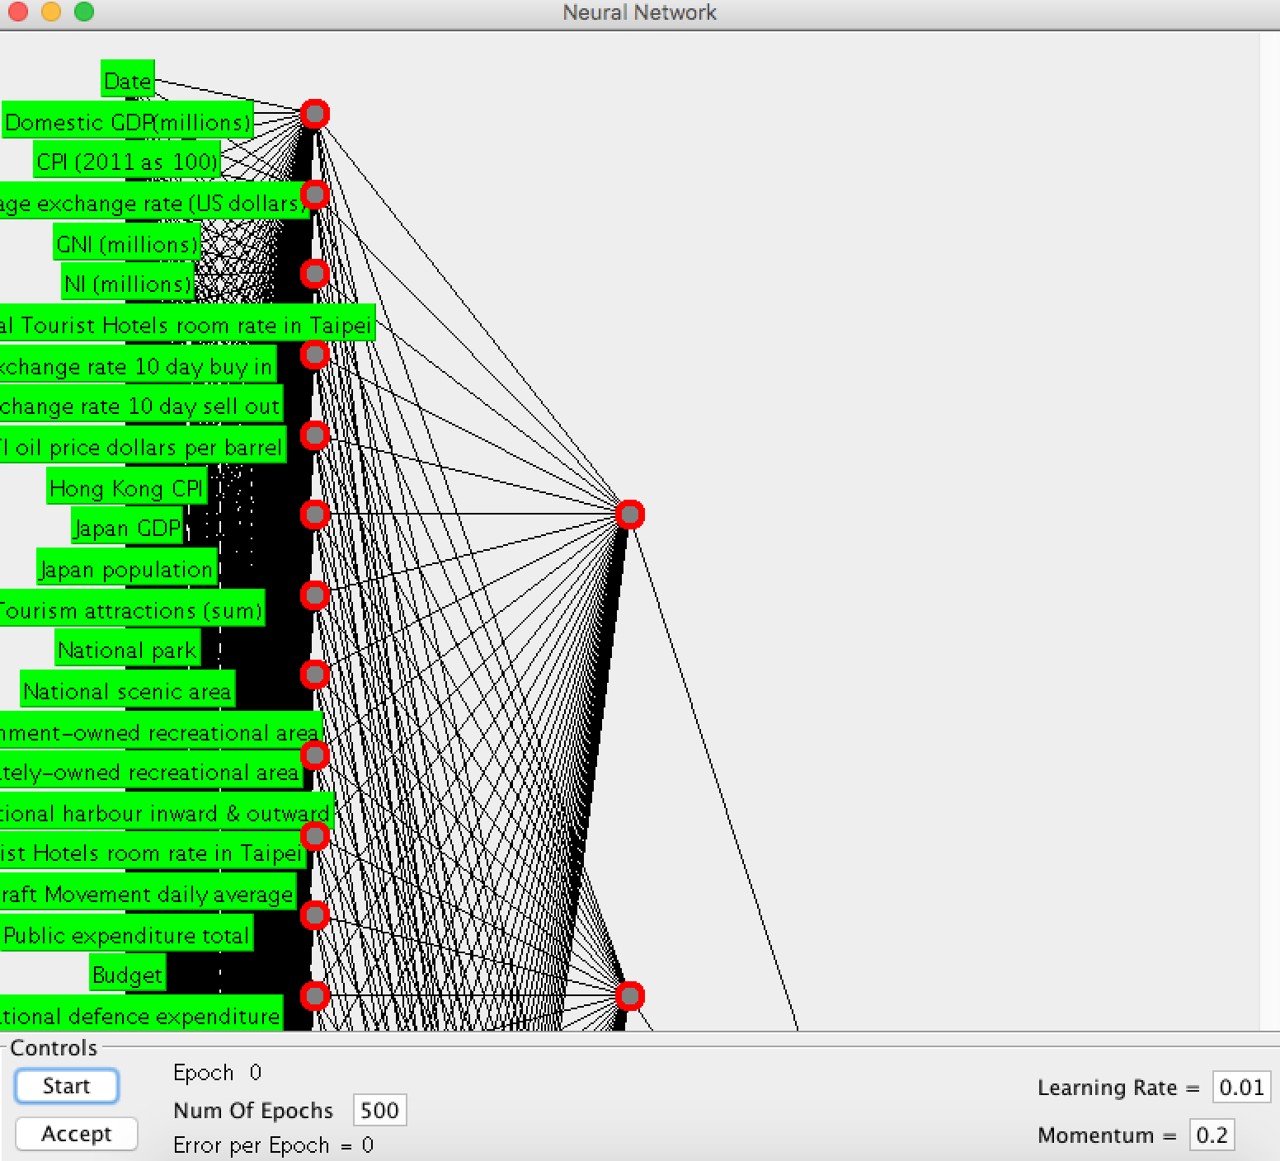
Available tool: Weka
Multilayer perception

Slide 14
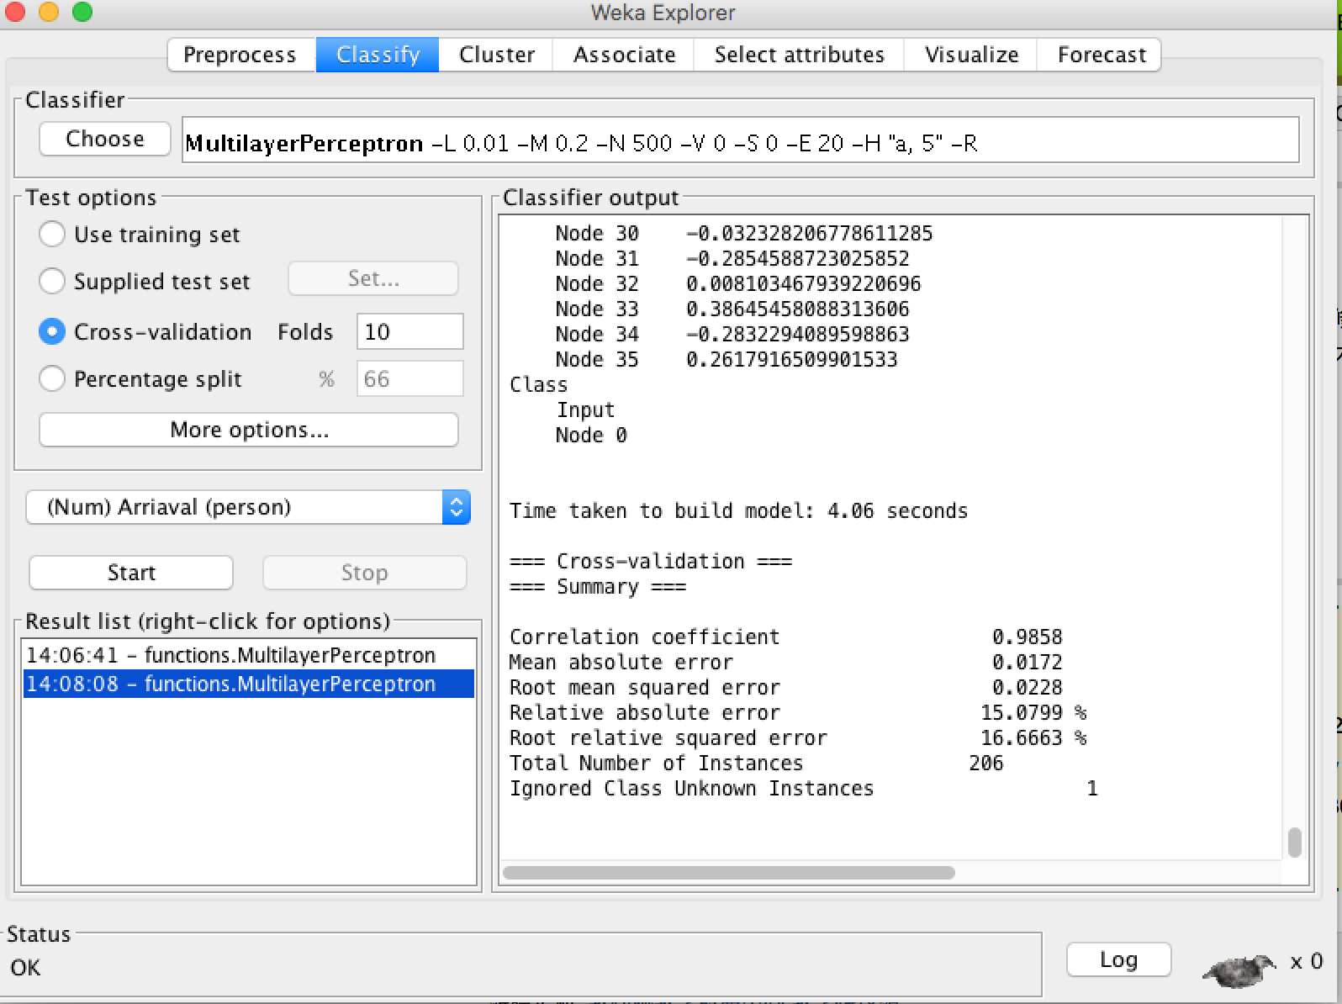
Available tool: Weka
Multilayer perception

Slide 15
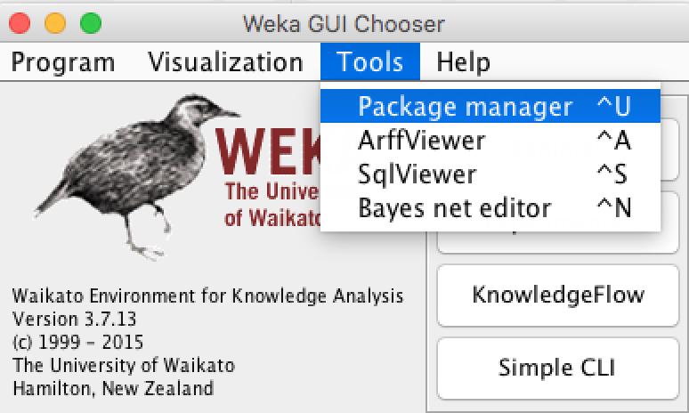
Available tool: Weka
Package manager

Slide 16
Simple example
Goal
Want to find whether the economic situation in a country would effect the arrival # of tourists?

Slide 17
Simple example
Load data

Slide 18
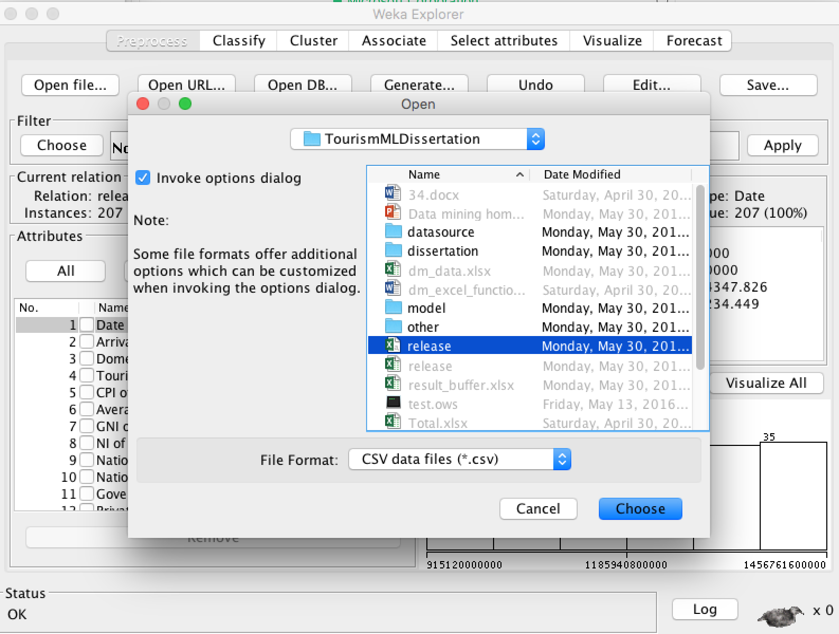

Slide 19
Simple example
Identify which attribute which you want to keep and remove the other. Note that the removed attribute will still be in file, this action will only remove attribute from memory.

Slide 20
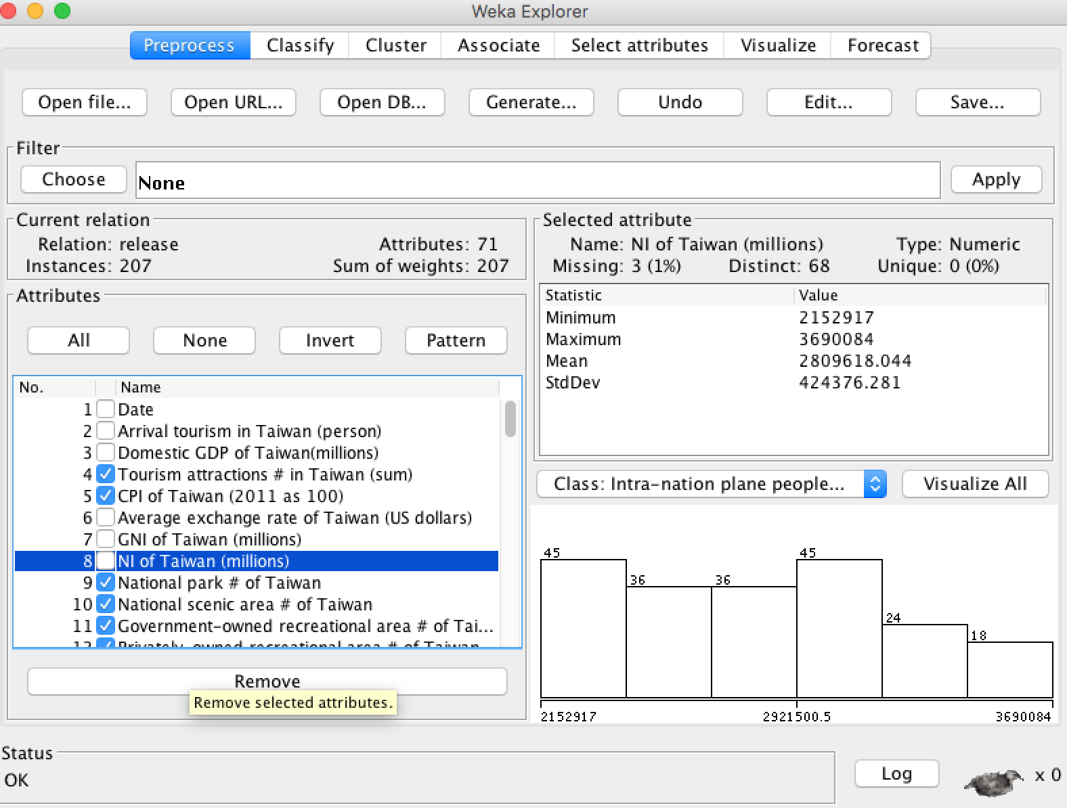

Slide 21
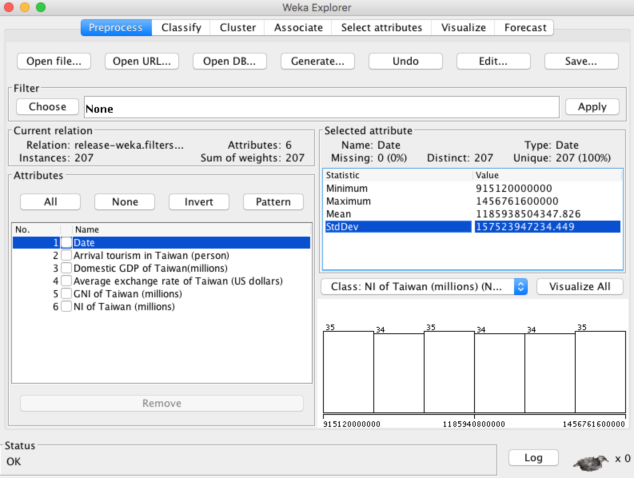

Slide 22
Simple example
Choose appropriate algorithm

Slide 23
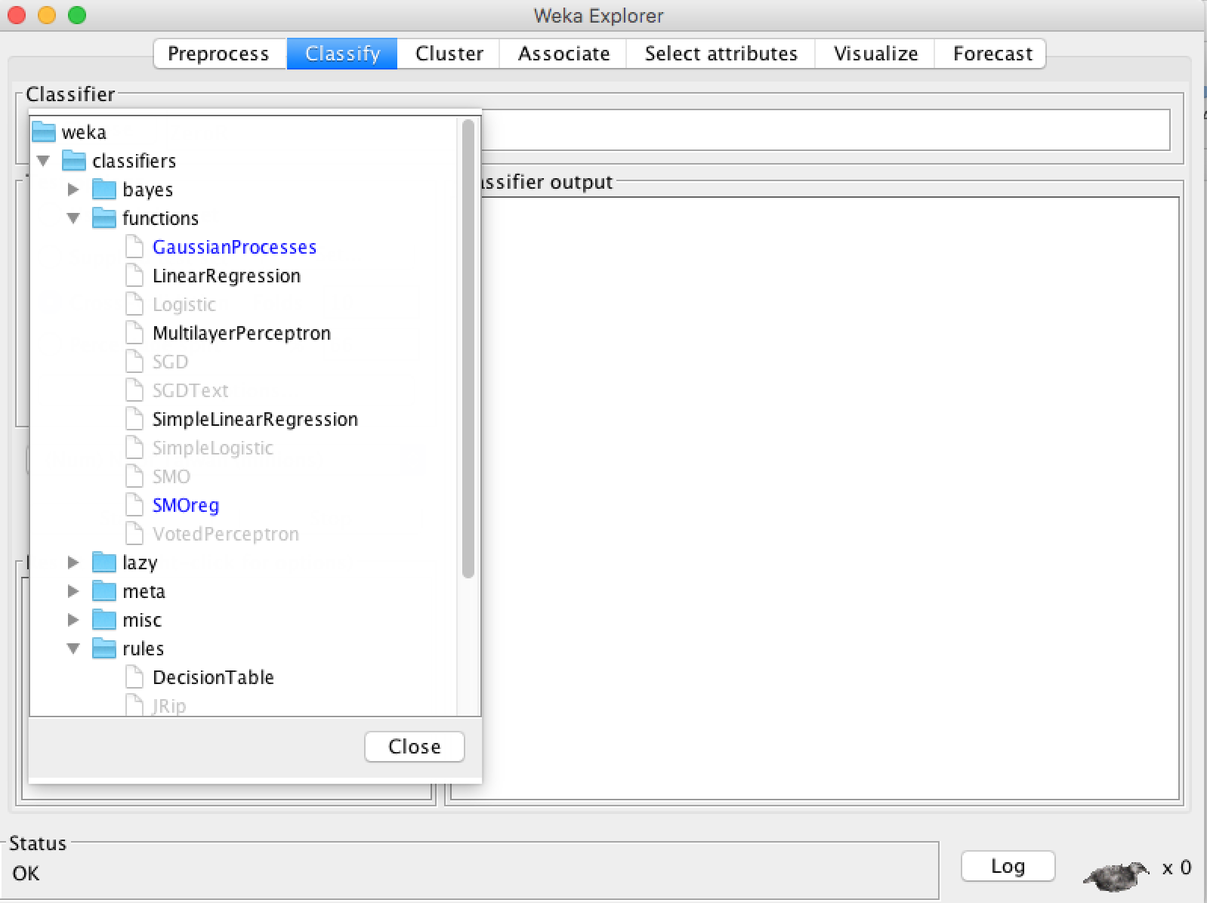

Slide 24
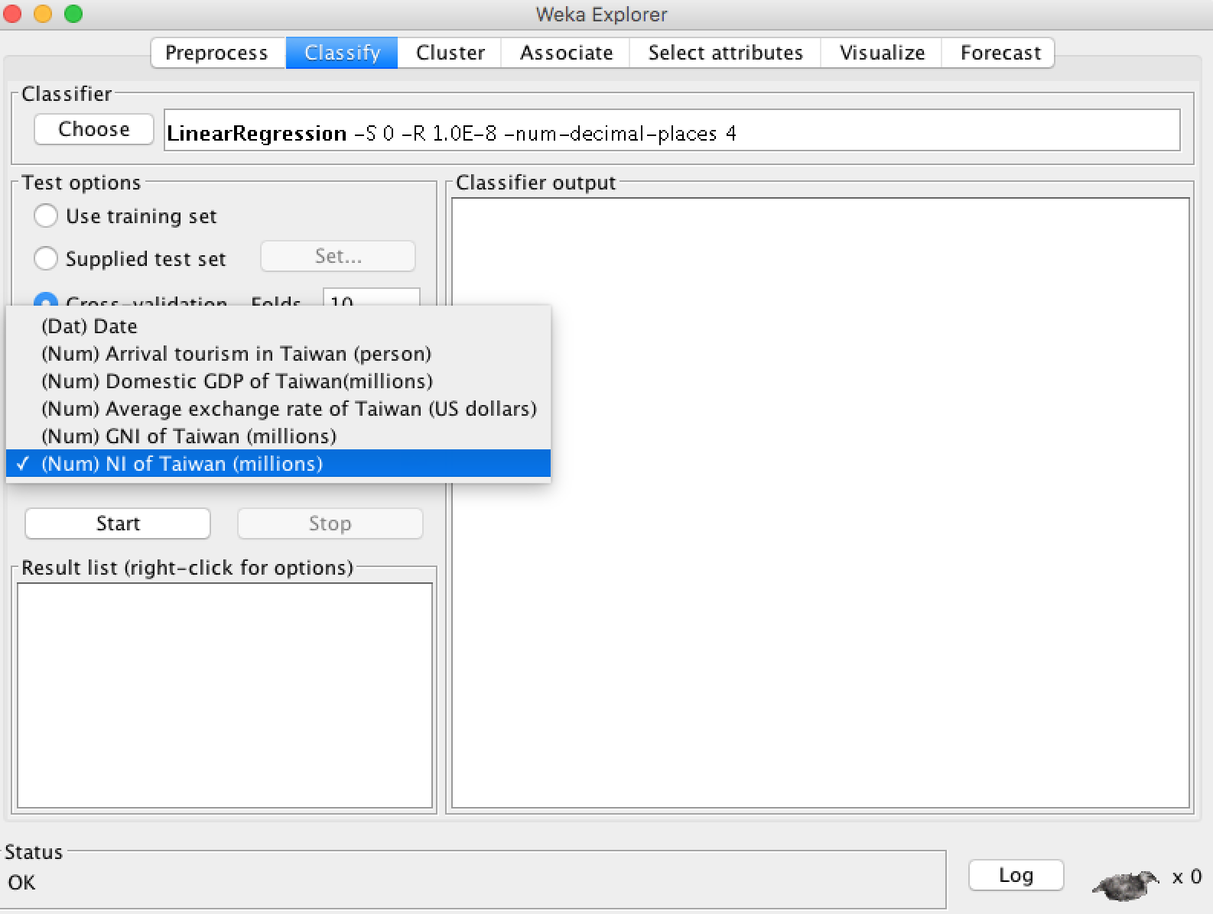

Slide 25
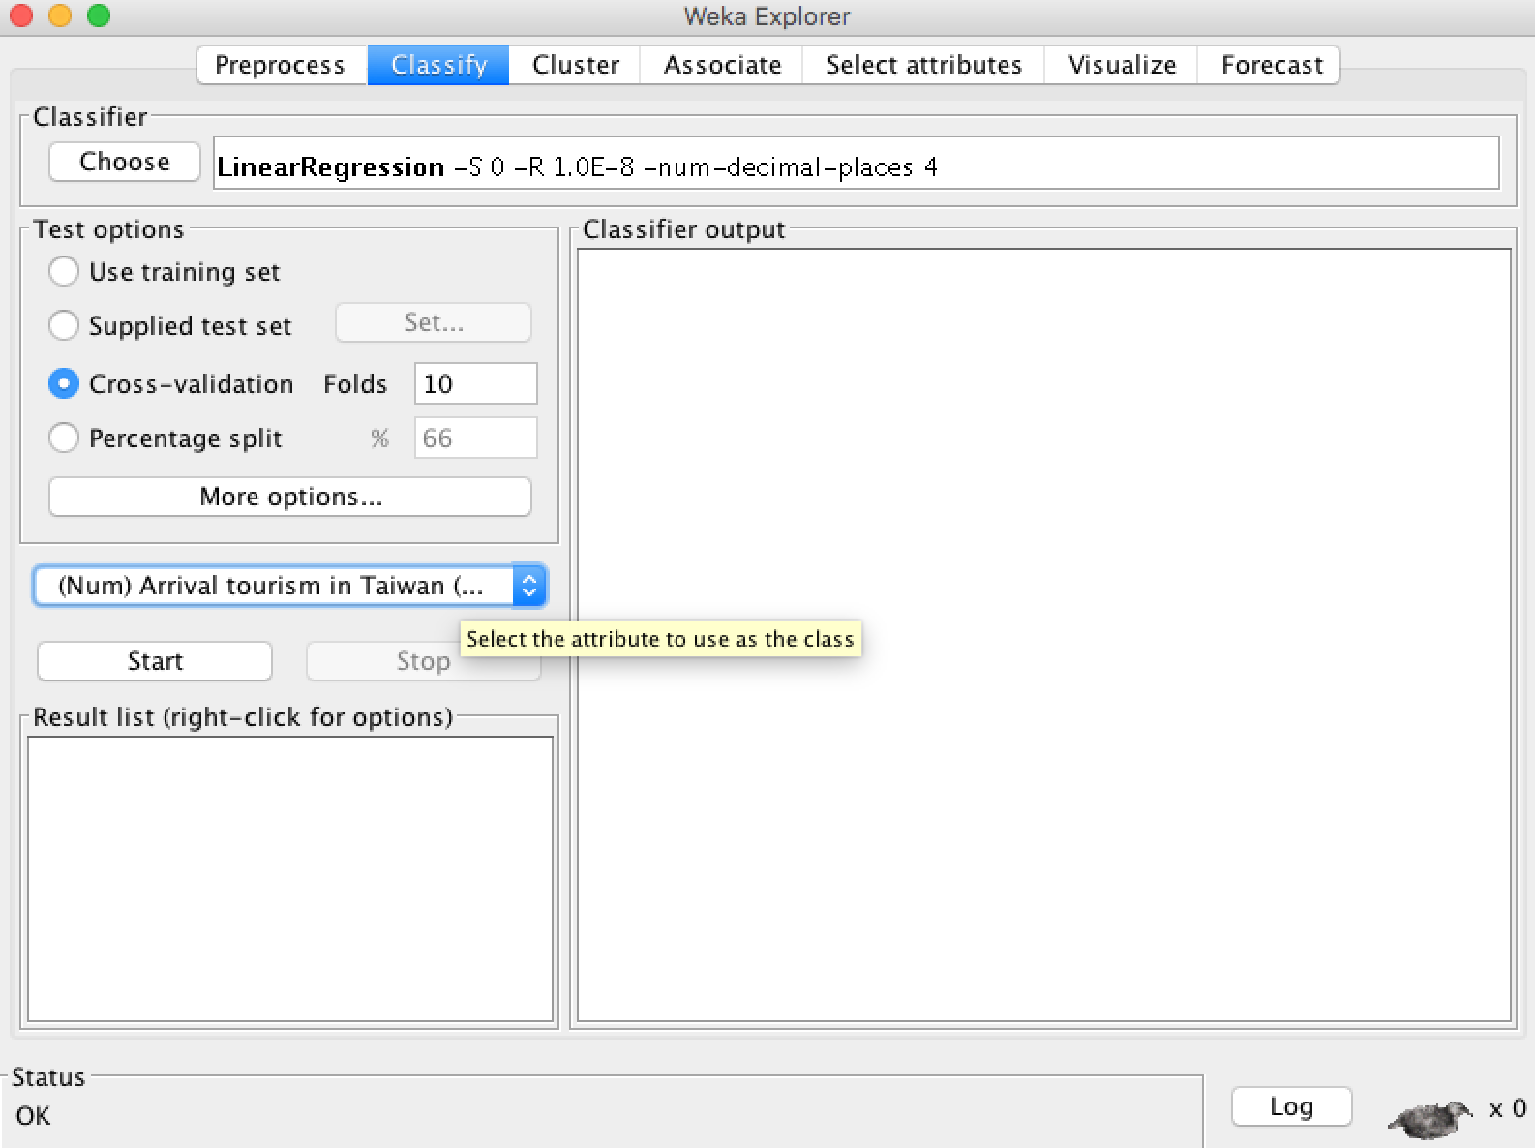

Slide 26
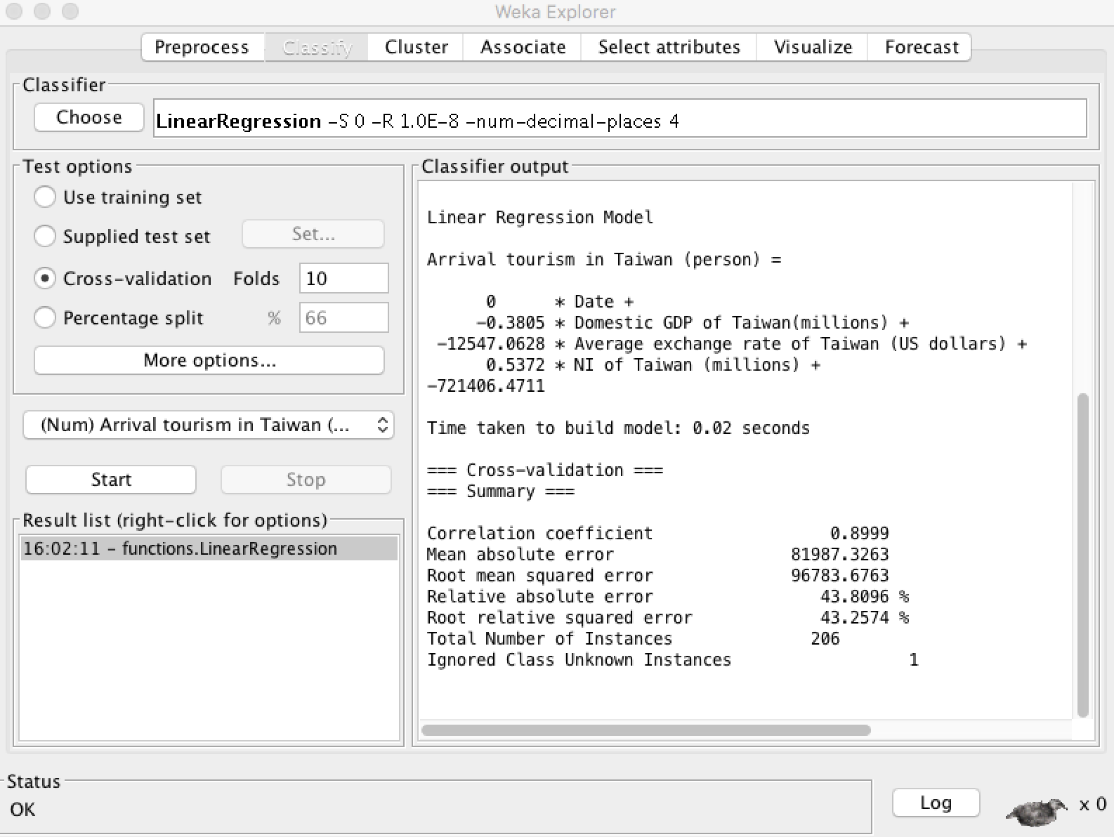

Slide 27
Simple example
Evaluate the result

Slide 29
Simple example
Observing that the arrival # of tourists in Taiwan is 100000 – 1000000
(10^5 - 10^6)
Root mean squared error 96783.6763
Oh that’s inaccurate
Maybe use more attribute?

Slide 30
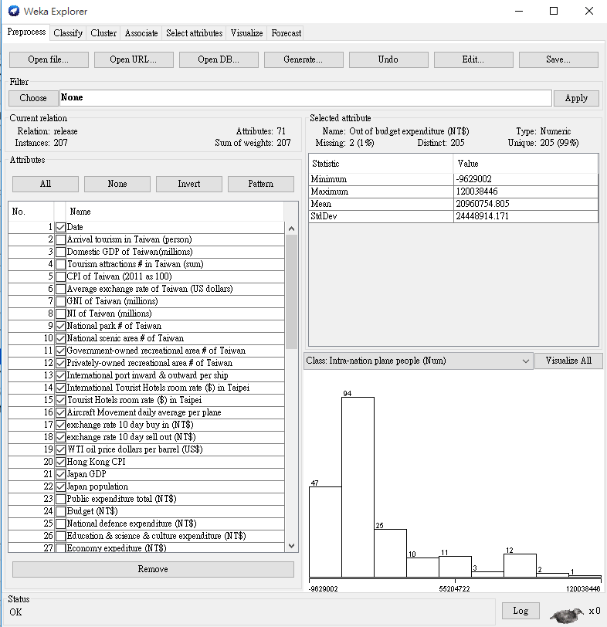

Slide 31
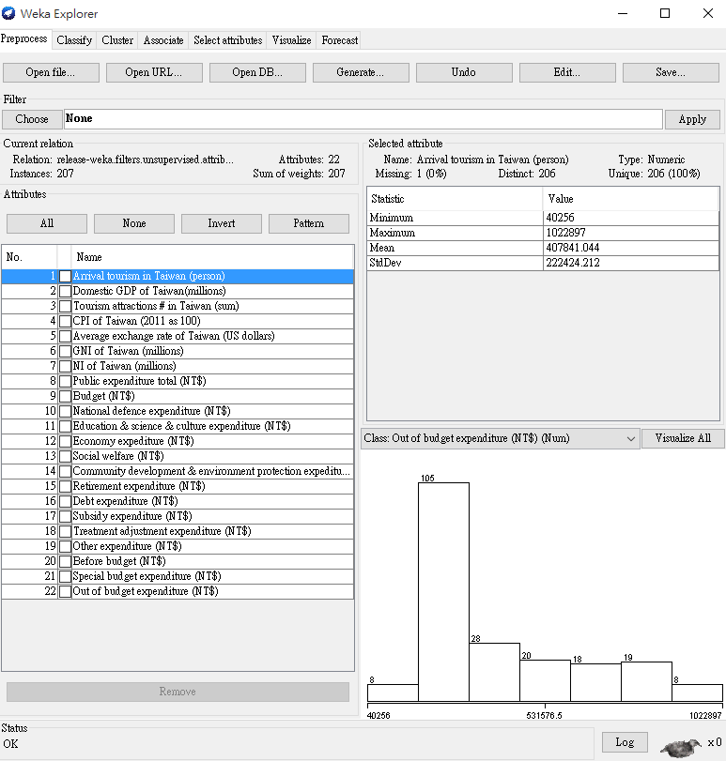

Slide 32
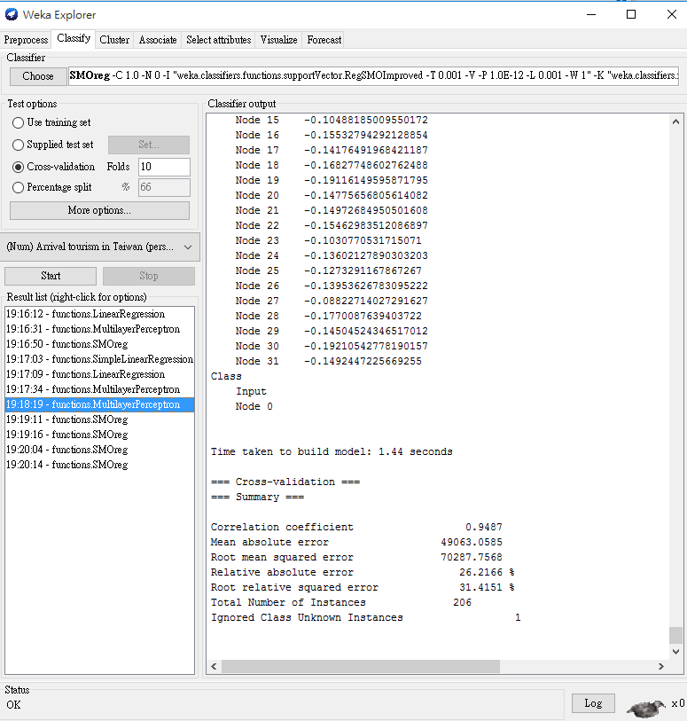

Slide 33
Simple example
This time we use another function named multilayer perception (backward propagation neural network with the layer are set a, 20, 20 & learning rate 0.02)
REMS 70287.7568 is better now

Slide 34
How to start (project structure)
Decide a topic (Will the arrival # of tourist be affected by the weather?). Why choose this?
Some competition on https://www.kaggle.com/competitions
Reference to thesis?

Slide 35
How to start (project structure)
Use provided data set or prepare your own data set.
Data source?

Slide 36
How to start (project structure)
Use a tool you like to perform data mining techniques to find interesting information.
Describe it briefly.

Slide 37
How to start (project structure)
Understand which algorithm is available for your topic
Understand how to input the data set properly
Understand how to tune the parameters
Evaluation on the result
Visualization?

Slide 38
How to start (project structure)
Compare the result from different algorithms?
Compare the result from different parameter adjustment?
Which will get the better result?

Slide 39
How to start (project structure)
Conclusion
Noted that the points above are just for alternatives, you won’t need to do all of them. Other meaningful issues in the process of data mining but not-mentioned above is encouraged to included in the project.

Slide 40
Other tools
Other tools or data mining framework
Orange http://orange.biolab.si
Scikit-learn http://scikit-learn.org/stable/
Matlab http://www.mathworks.com/products/neural-network/?s_tid=srchtitle
R https://www.r-project.org

Slide 41
Materials
How to interpret error measures in Weka output? (MSE, REMS, RAE, RRSE)http://stats.stackexchange.com/questions/131267/how-to-interpret-error-measures-in-weka-output
Data mining with WEKA, Part 1: Introduction and regression https://www.ibm.com/developerworks/library/os-weka1/
Data mining with WEKA, Part 2: Classification and clustering https://www.ibm.com/developerworks/library/os-weka2/
List of tools http://wiki.pentaho.com/display/DATAMINING/Data+Mining+Algorithms+and+Tools+in+Weka

Slide 42
Question
要做甚麼? 使用資料礦掘技巧找出資料集中隱含資訊
資料集欄位敘述? Xls那份的data source description工作表
Any further question can be mailed at Yu-Wei Chang ernie55ernie@gmail.com or the teacher rayichang@ntu.edu.tw

